Slide 1
Object Classification Using Google AI Open Images
Atindra Bandi, Alyson Brown, Sagar Chadha, Amy Dang, Jason Su

Slide 2
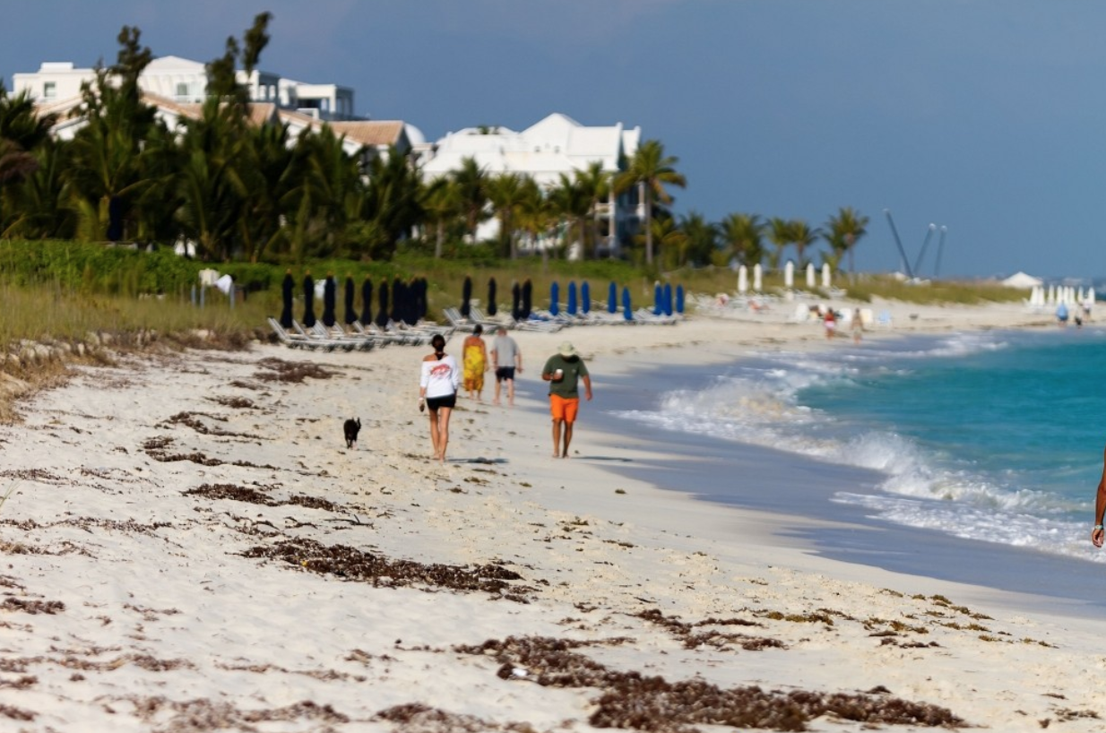
Notes:
Here's the background. Computers are getting better and better at vision. But in a few critical ways, they still can't match a human’s intuitive perception. For example, what do you see when you look at this photo? [beach photo + description]
Can a computer provide as precise an image description?

Slide 3




Table of Contents
Methodology
Data Preprocessing
YOLO Object Detection Algorithm
Cost Function
Results
Accuracy - mAP
Next Steps

Slide 4



Importance
CNNs are used for real time processing
Robotics, self driving cars
Companies use image tagging, classification, & object detection
Facebook, Apple, Behold.ai
Notes:
Object detection is a central task in computer vision, with applications ranging across search, robotics, self-driving cars, and many others. As deep network solutions become deeper and more complex, they are often limited by the amount of training data available.

Slide 5

Methodology
Understand CNNs
Customize inputs to YOLO for training
Develop YOLO architecture
Load pre-trained weights for YOLO
Randomize weights for last layer and train on Kaggle training data
Notes:
Understand CNNs - convolutions, filters, padding, strides and transfer learning

Slide 6
12MM bounding-box annotations
500 object classes
1.7M training images
Hierarchical class labels; person (man, woman), clothes (shirt, trouser)
Highly varied images with ‘new’ objects (‘fedora’, ‘snowman’, etc.)
Notes:
Data:
12M bounding-box annotations for 500 object classes on 1.7M training images
Highly varied images that contain brand new objects like “fedora” and “snowman”.
Hierarchical class labels - Person (Man, woman), Clothes(Shirt, Trouser)
Data Preprocessing:
Selected 50 classes for prediction on images.
Chose 300k images out of the training data with the chosen classes.
Created an input file with each image and a dictionary of all objects present in the image. Used this as input to the YOLO algorithm

Slide 7
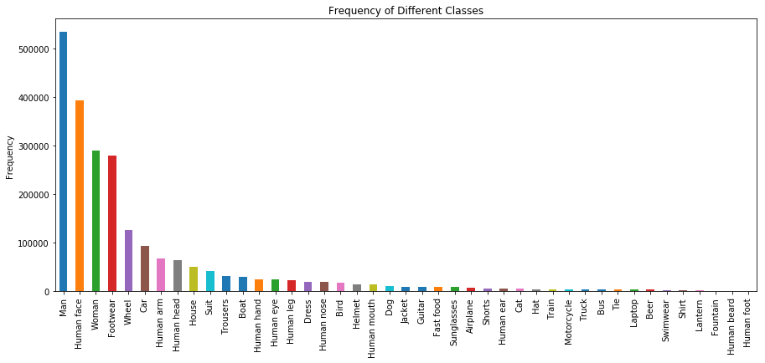
Frequency of Classes (43 classes)
Notes:
Can’t use all 500 classes, can’t predict classes on the tail
At least 500 images

Slide 8
Data Preprocessing
43 classes for prediction
300k images with the chosen classes
Input file with each image & dictionary of objects present
Input into YOLO algorithm
Notes:
700k images >> long training time, low confidence
GCP >> epoch
Input >> dictionary

Slide 9
YOLO Object Detection Algorithm
Model Architecture and Parameters
Bounding Box Predictions and Loss function
(Redmon, J, Girshick R, & Farhadi, A. “You Only Look Once: Unified, Real-Time Object Detection.” Retrieved from https://arxiv.org/pdf/1506.02640.pdf) 2016
Notes:
Santosh Divvala∗†, Ross Girshick¶ , Ali Farhadi

Slide 10
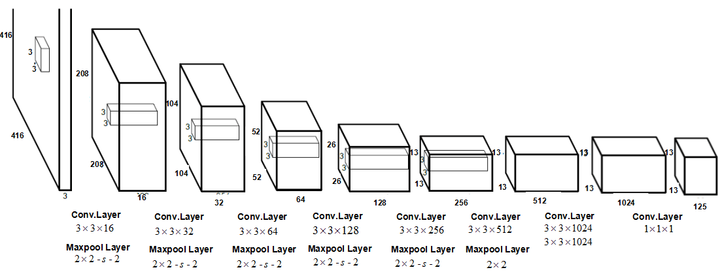
Model Architecture
23 convolutional layers. Leaky RELU activation. Batch Normalization.
Change input image dimensions to 608X608
Y = x
Randomize weights for the last layer and train on our data.
Y = 0.1* x
Leaky RELU
Notes:
Batch Normalization: Batch normalization leads to significant improvements in convergence while eliminating the need for other forms of regularization. By adding batch normalization on all of the convolutional layers in YOLO we get more than 2% improvement in mAP

Slide 11
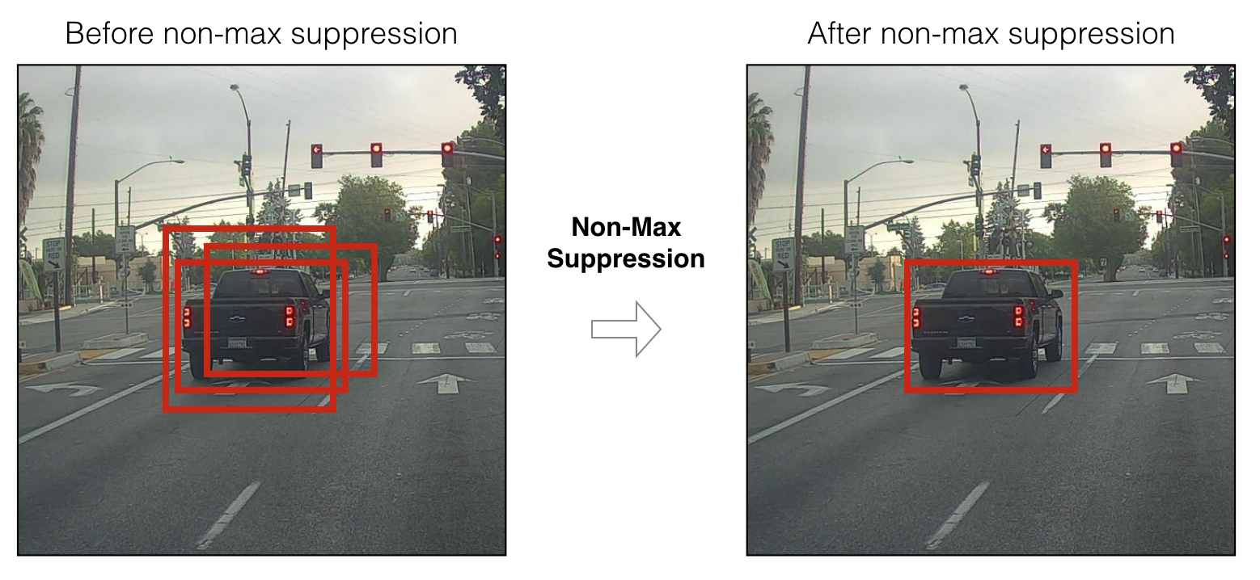
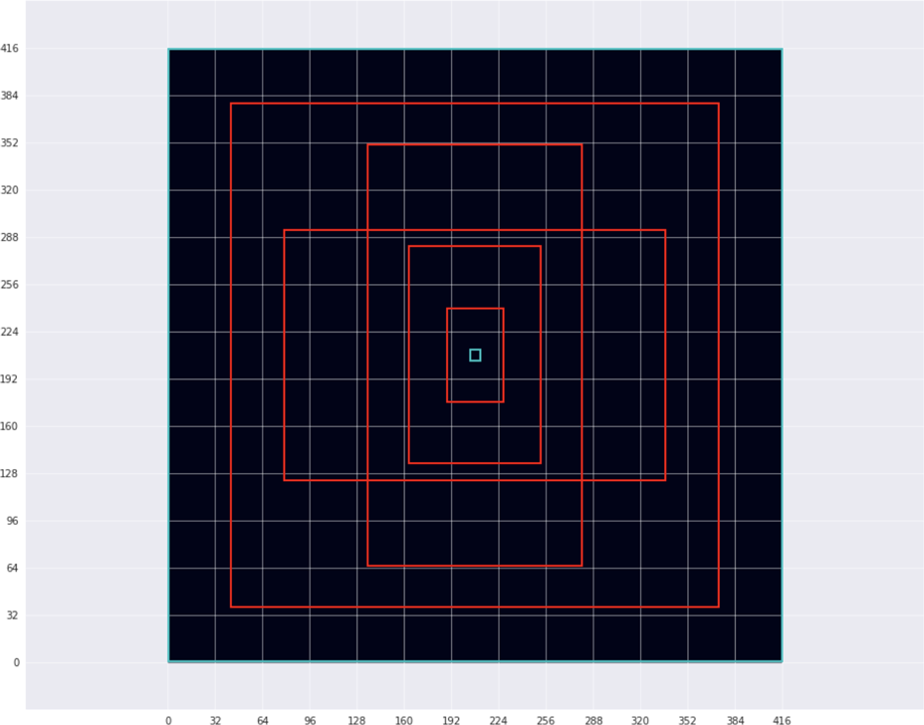
Bounding Box Predictions
We cannot expect each object to conform to the grid cell size. This is where anchor boxes come in.
19
Probability of observing object in the box
P_{c}
B_{x}
B_{y}
B_{h}
B_{w}
C₁
C₂
C₃
C₄
.
.
The given grid cell dimensions output 19*19*5 bounding boxes.
Non-max suppression helps cut down on bounding boxes using IOU and confidence thresholds.
Coordinates of the bounding box
19
Probabilities of observing each class
Anchor boxes help capture objects of different sizes
Output Dimension = (4 + 1 + #Classes)*#Anchor_Boxes

Slide 12
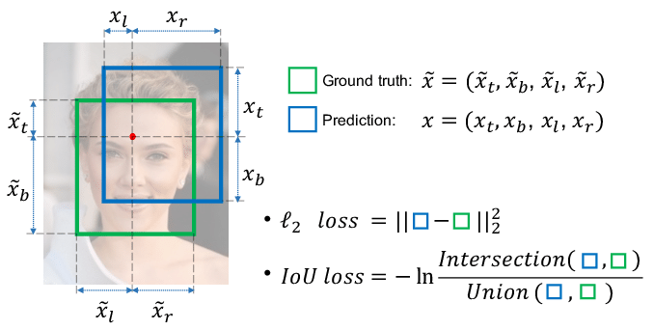
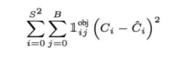
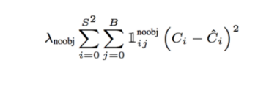
Loss Function
“Identify the right object at the right place with a high confidence.”
Classification Loss
Squared error of class conditional probability for each class, if an object is detected
Localization Loss
Penalize bad localization of center of cells
Penalize the bounding box with inaccurate height & width
Confidence Loss
Measure the objectness of the box
Actual Class | [0.0, 0.0,1.0,0.0]
Predicted Class | [0.1, 0.3, 0.6,0.0]
Loss | 0.26
Notes:
Talk about Adam parameters and SGD and SGD was very slow and had higher initial errors. Also SGD with momentum.
optimizer = Adam(lr=0.5e-4, beta_1=0.9, beta_2=0.999, epsilon=1e-08, decay=0.0)
optimizer = SGD(lr=1e-4, decay=0.0005, momentum=0.9)
optimizer = RMSprop(lr=1e-4, rho=0.9, epsilon=1e-08, decay=0.0)
Talk about the Reduce Learning Rate on Plateau to reduce learning rate
Error analysis of YOLO compared to Fast R-CNN shows that YOLO makes a significant number of localization errors. Furthermore, YOLO has relatively low recall compared to region proposal-based methods. Thus we focus mainly on improving recall and localization while maintaining classification accuracy.

Slide 13
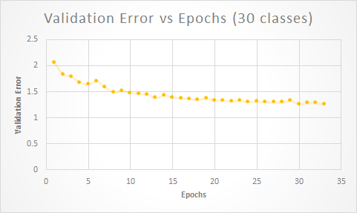
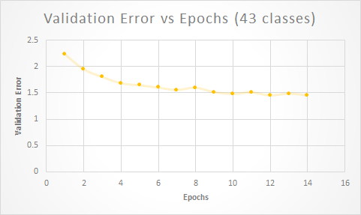
Validation Error vs. Epochs
Optimizer: Adam with dynamic learning rate with an initial learning rate of 0.5 * 10⁻⁴

Slide 14
Model Results
Notes:
YOLO as a baseline algorithm , it was not trained on these classes - it was trained on person not man & woman.
Retrained -
Remember that we retrained the last YOLO convolution layer on 43 classes - some of which we’ll show you here

Slide 15
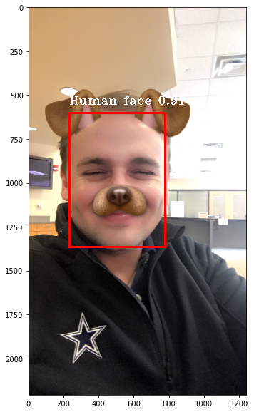
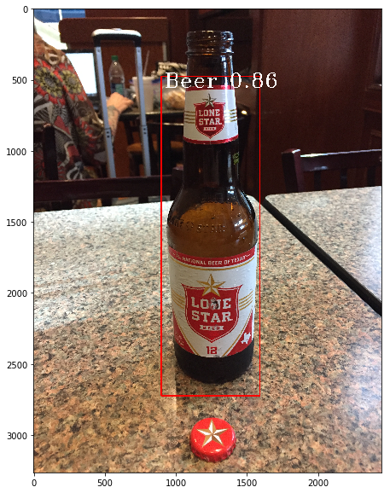
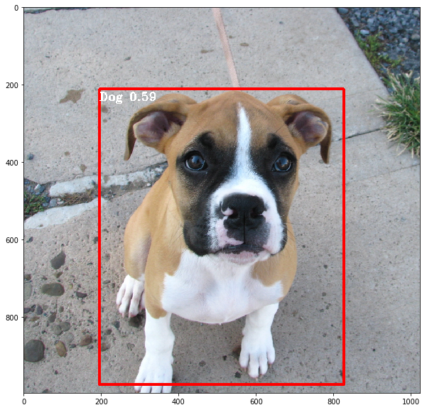
Results
Dog 0.59
Human Face 0.91
Beer 0.86
Notes:
YOLO as a baseline algorithm , it was not trained on these classes - it was trained on person not man & woman.
Retrained -

Slide 16
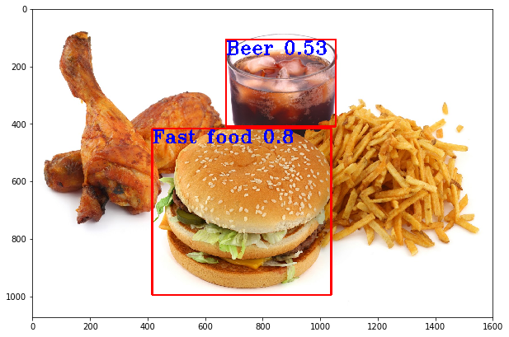
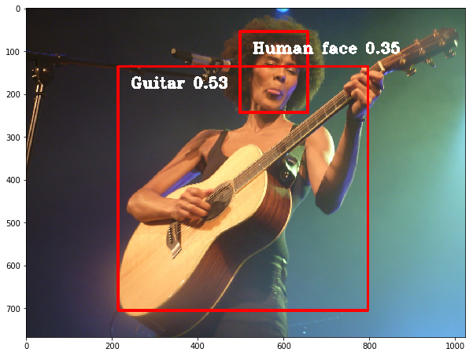
Results
Fast Food 0.8 | Beer 0.53
Guitar 0.53 | Human Face 0.35
Notes:
Most of the images are real or taken from images, not from training set

Slide 17
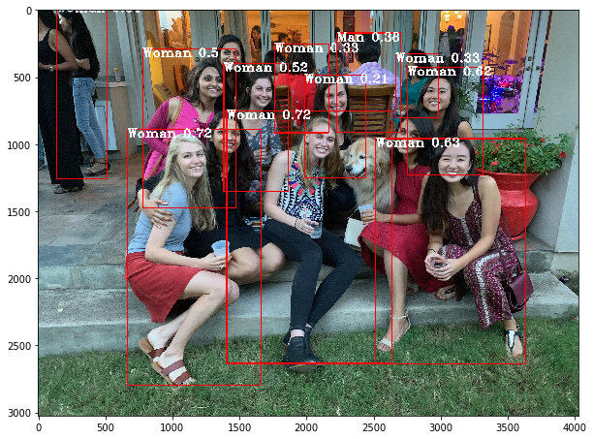
Notes:
Picture from Barua’s party :)

Slide 18
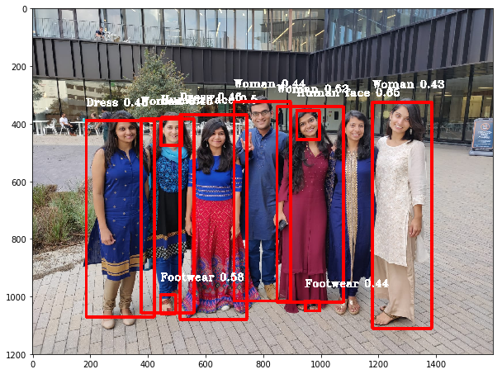
Notes:
So many objects & struggles to differentiate
It’s predicting women for all & while it is correct mostof the time, it struggles because the model takes into account the pixels arround it - predicting Atindra to be a woman

Slide 19
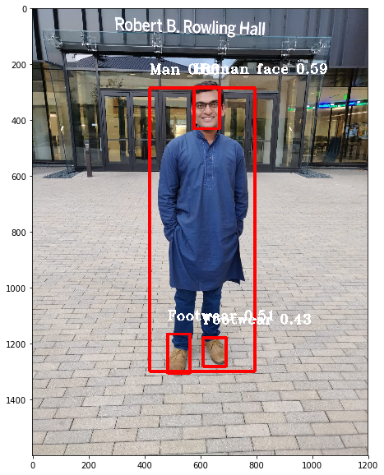
Notes:
However, when he is alone, it becomes more obvious. Another cool thing to note is that our model was able to predict larges objects like man & small like footwear

Slide 20
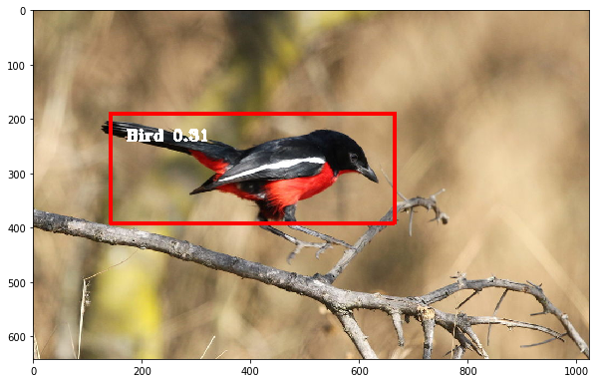
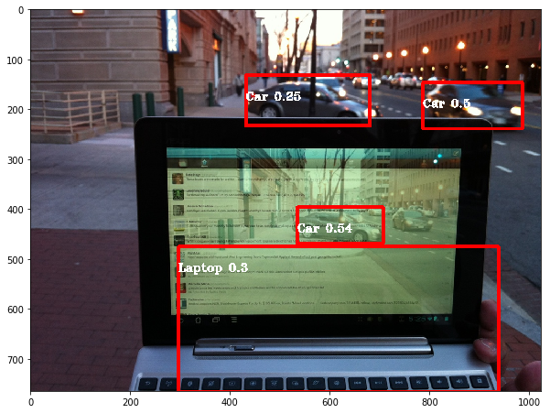
Results
Notes:
Some more examples of classes we trained on - bird, laptop, car -- interesting about car
Way its trained on car - even predicted car from reflection

Slide 21
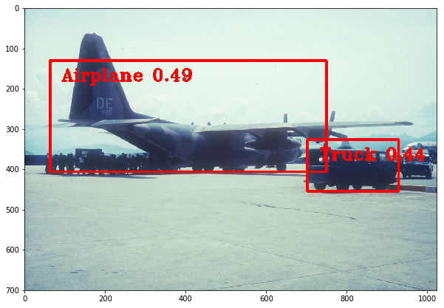
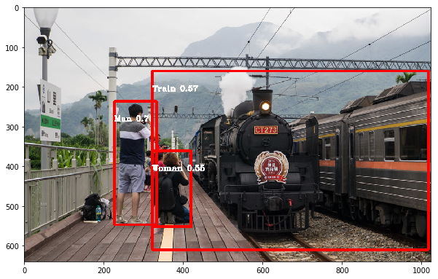
Results
Notes:
Took Yolo , trained on other classes, and we took last layer & retrained on some news classes (person vs man woman, house, boat, footwear,, etc) (example: it previously had car - now it have car, bus, aircraft, motorcycle, truck)

Slide 22
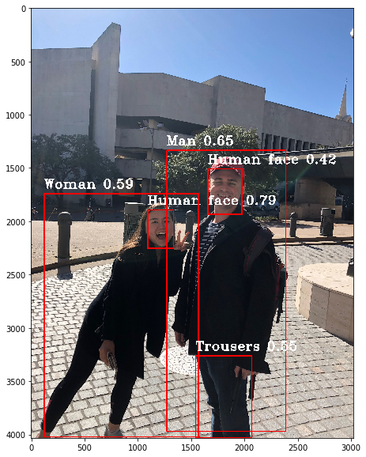
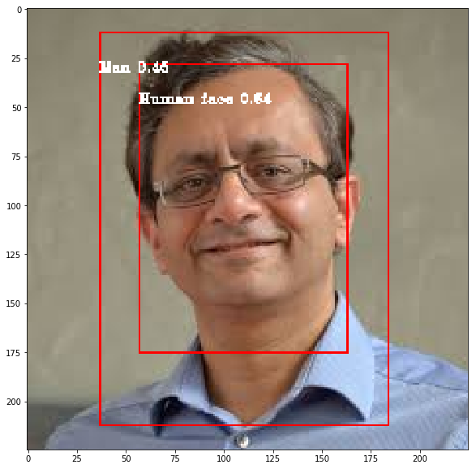
Results
Notes:
Trousers - Ghosh

Slide 23
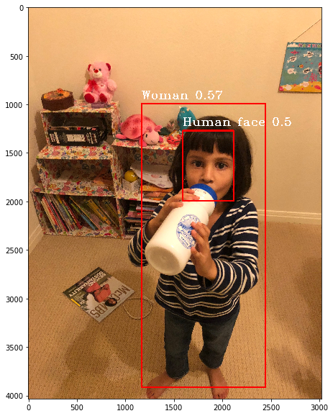
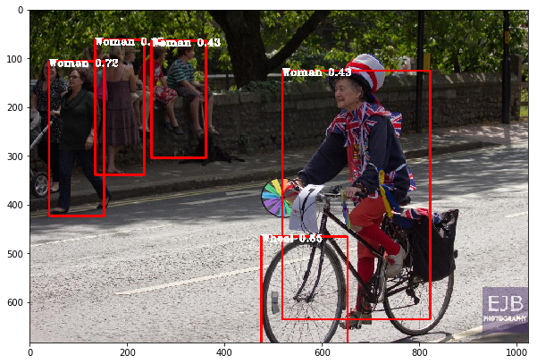
Results
Notes:
Jui’s daughter is cute, Wheel

Slide 24
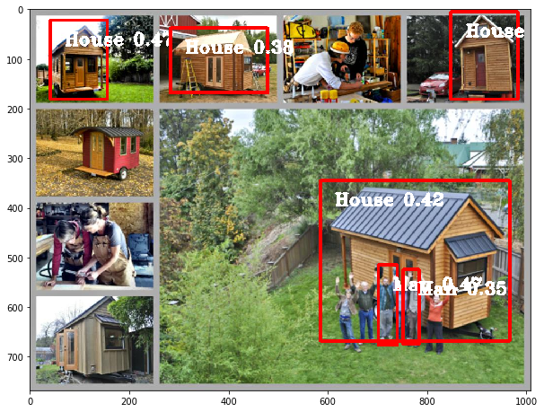
Notes:
House

Slide 25
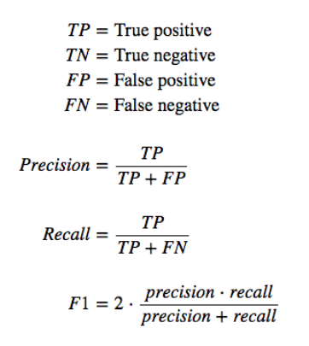
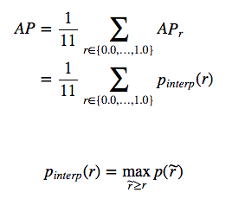
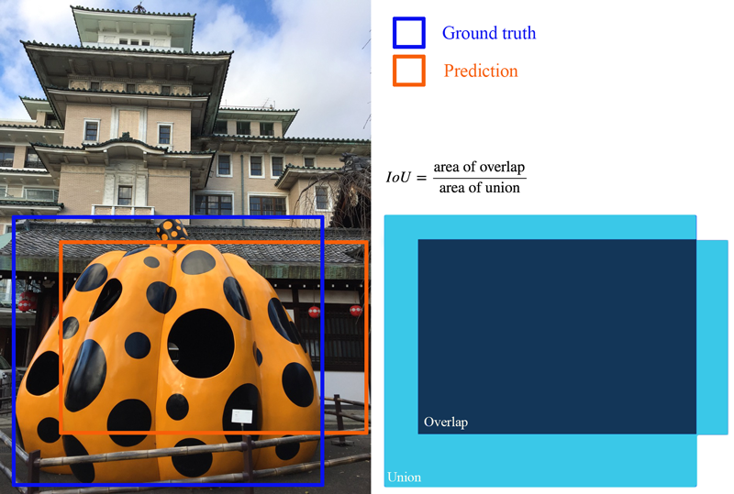
Accuracy - mAP score (Mean Average Precision) *
Average Precision (AP)
Intersection over Union (IoU)
mAP = average of the maximum precisions at different recall values (over all classes and/or over all IoU thresholds)
Notes:
Metric to evaluate the accuracy of object detection challenges
AP: Average Precision
Precision & recall
Precision = how accurate your predictions are (% of positive predictions are correct; proportion of TP) = TPR
Recall = how good you find all the positives (proportion of TP out of all possible outcomes)
Recall value increases as we include more predictions, but the precision will go up/down = inverse relationship and dependent on the model score threshold used (our project = confidence)
To calculate the AP, for a specific class (say a “person”) the precision-recall curve is computed from the model’s detection output, by varying the model score threshold that determines what is counted as a model-predicted positive detection of the class.
Then take average value of the precision across all recall values
→ AP score = mean precision at the set of 11 equally spaced recall values (Recall_i = [1, 0.1, …, 1.0]
IoU: Intersection over Union
How much overlap between 2 regions - how good is our prediction in the object detector with the ground truth (real object boundary)
Model object detections are determined to be true or false depending upon the IoU threshold

Slide 26

Next Steps
Calculate mAP Score
Training on more classes
Correcting for imbalanced data
Trying an ensemble of different models (i.e. MobileNet, VGG)
Creating story from images

Slide 27
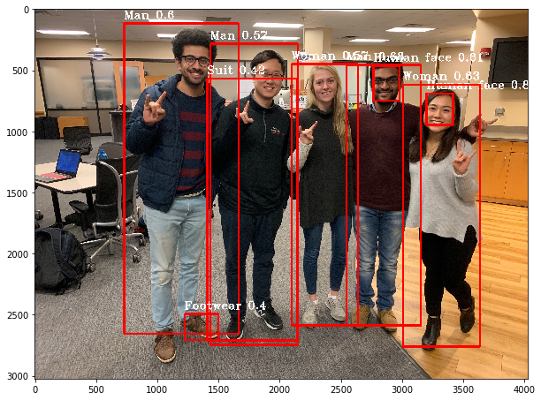
Thank You!
Any questions?

Slide 28
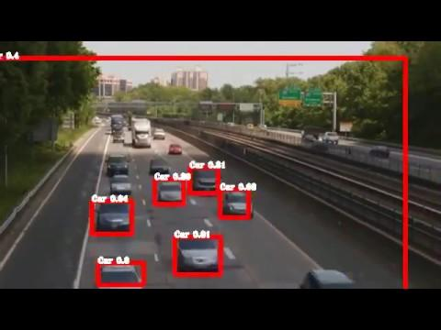

Slide 29
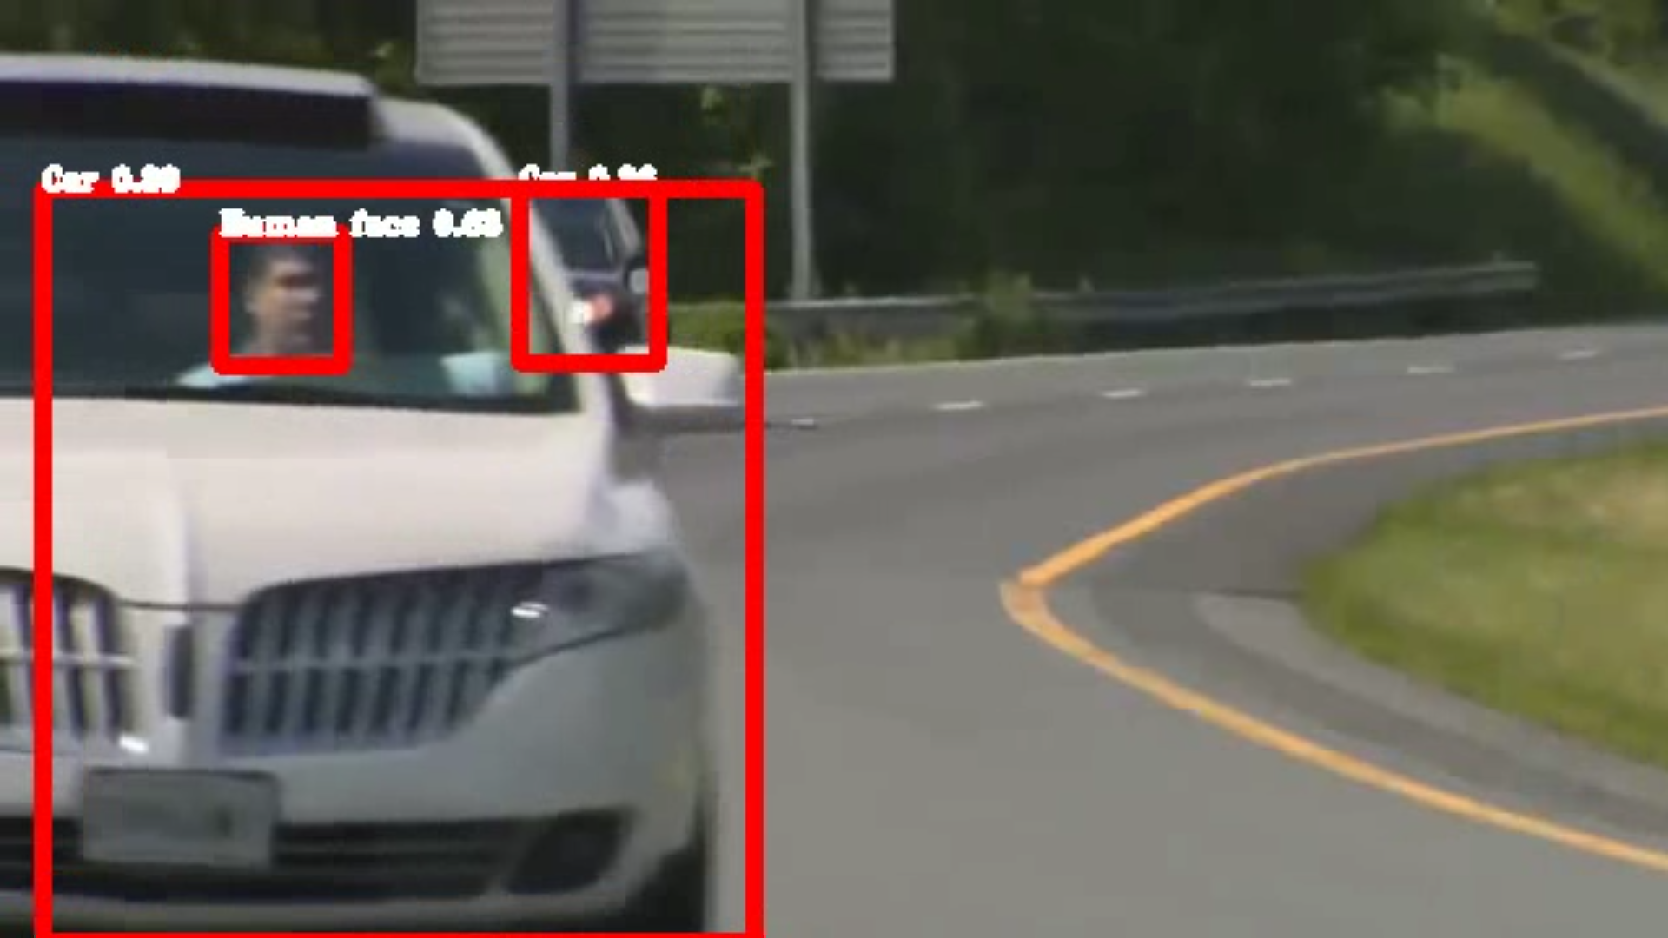

Slide 30
